Slide 1
Lecture 7-8: Probability for robotics
Risto Ritala
Oct 1, 2018
IHA-4306 Fundamentals of mobile robotics

Slide 2
Content of the lecture
Why – sources of uncertainty
What is probability?
An axiomatic set of rules
Classical interpretation – frequentist approach
Bayesian interpretation – ways of expressing beliefs
Summaries of uncertain variables
Most likely state value
Entropy
Random variables and their summaries: mean; (co)variance
The key concepts and formulas
Statistical independence
Conditional probability & Bayes rule
Sample based representation of probability distributions

Slide 3
Sources of uncertainty
Consequences of actions are not known completely
Probabilistic model
No model at all
Costs of actions are not known completely
Sensing capabilities are not complete
Current system state is not known (localization problem)
Map of environment is not known completely
Communication in multi-robot system is not completely reliable
Robots cannot communicate their current states and thus the global state is not known completely
In this course
Consequences of actions (this lecture)
Single robot state & incomplete sensing
Mapping
Intro to simultaneous localization and mapping (SLAM) and decision making under all these uncertainties (POMDP)

Slide 4
What is probability? The axiomatic approach
Set of events in sample space, satisfying the three axioms
For all events the probability of an event is a number in [0 1].
Probability of the whole sample space is 1.
Meaning. Some event will happen
If E(i) is a sequence of disjoint events, the probability of union of E(i) is the sum of the probabilities of E(i).
Everything in the calculus of probability follows from this!
For the axioms to make sense the set of events must satisfy
Sample space is in the set of events (”something happens” is an event)
Any union of events is an event (if ”one thing happens” is an event and ”another thing happens” is an event, then ”one or another thing” happens is an event)
A complement of an event is an event (if ”thing happens” is an event, then ”thing does not happen” is an event)

Slide 5
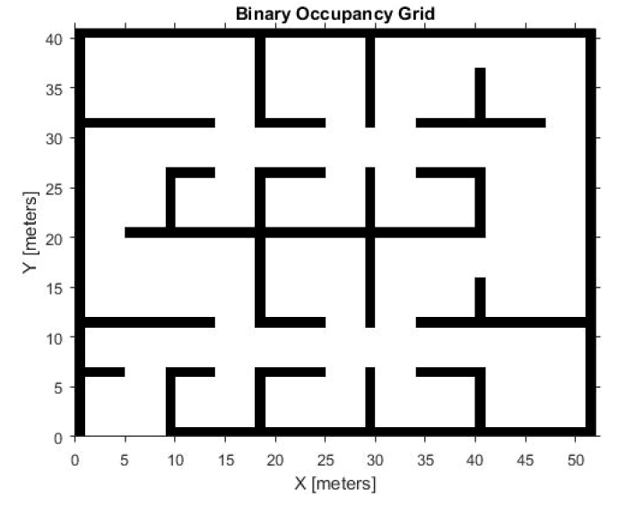
An example: uncertain maps
Occupancy grid: made out of ”pixels”
of which each can be occupied by an obstacle
or not
N pixels: 2^{N} maps
Uncertain maps: assign probabilities to each of
map options; then you have a probability system

Slide 6
An example: uncertain maps
A four pixel map:
Event, example: ”upper left and right are not occupied”
3/128
1/128
27/128
1/128
(3+13+13+5)/128 = 17/64
13/128
1/128
2/128
20/128
Event, example: ”at least three are occupied”
13/128
1/128
2/128
11/128
5/128
1/128
23/128
4/128
(2+23+1+11+2)/128 = 39/128

Slide 7
Where do the values for probabilities come from?
NOTE: probability calculus is not concerned with this; it just tells how to compute with them once you have got them
Classical interpretation of probability (frequentist/statistician)
Repeat experiments on the obvject of interest, count how many times you get each outcome, and declare the probability as the ratio of outcomes to total number of experiments
Obviously, does not work with the robot map example: no means to conduct the experiments
Bayesian interpretation: probabilities express (subjective) beliefs
Scientific Bayesian method
If you know nothing about the object, select probabilities that express highest possible uncertainty
Map example: all configurations have the same probability, 1/16
Once you get (possibly uncertain) observations about (parts of) the state (map), update the probabilities
General method for beliefs
Betting: what would you consider as ”fair odds”, if you were to bet if the event will take place or not

Slide 8
Summaries
Representative state value
Idea: ”I do not want to consider all uncertainties. Thus I pick a state value that is – somehow – representative, and plan and act as that would be the state value for sure.”
Map example: the map with highest probability
Do you foresee any problems if following this idea?
Measure of uncertainty
Idea. ”How many additional questions (with yes/no answers) I need (on the average) to ask in order to reveal the true state value for sure.”
Entropy:
Map example: S=3.24 (Try to find the questions!)
Note: For an impossible event p = 0, p*log(p) = 0 (taken as the limit p->0)
27/128

Slide 9
Random variables
Quite often we are interested in uncertain states that are vectors of real numbers rather than discrete states…
Robot’s x,y –location
.. and we may even want to make algebraic operations between states
Distance between two robots whose locations are uncertain
Real-valued random vector has a probability density function (pdf) f(x):
where is a an infinitesimal rectangle with corner at x and edges dx. The probability of any finite volume is obtrained by integrating pdf over the volume.

Slide 10
Random variables - summaries
Representative value
Most likely value:
Expectation value:
Uncertainty
Covariance:
Entropy is infinite!
Differential entropy:

Slide 11
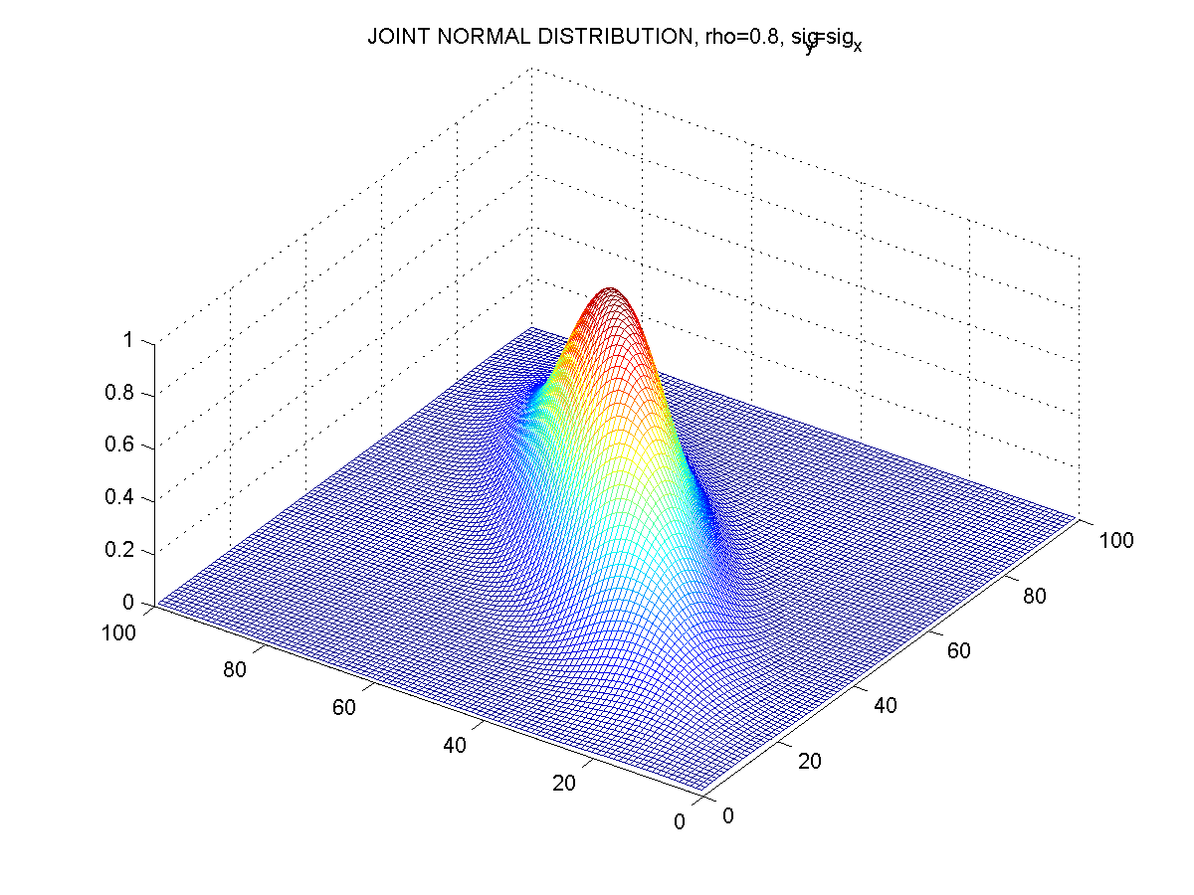
Random variables - Gaussian
Highly useful and versatile pdf is Gaussian

Slide 12
Key concepts and formulas
Statistical independence
Events A and B are independent, if P(A and B) = P(A)P(B)
Map example: if occupancies at different locations are independent, then
and system of N map pixel is characterized by N probabilities, rather than 2^{N}-1 probabilities in the general case
The probabilities on slide 6 do not describe statistical independence

Slide 13
Key concepts and formulas
Conditional probability: what is the probability that event A takes place if we know that B has taken place
Map example: A=upper left is occupied, B= at least three are occupied
(2+23+1+2)/128
28
(2+23+1+11+2)/128
39

Slide 14
Key concepts and formulas
Incomplete/uncertain observation of state is described as a conditional probability P(observation data=y|state=x)
Bayes formula is the recipe to ”once you get observations about the state, update the probabilities”

Slide 15
Key concepts and formulas
Map/incomplete exact measurement: we observe that UL is not occupied. What are the probabilities of the states.
P(data=not occupied|state)=1 if UL is green and 0, if UL is red
Data =
”not occupied”
0
3/128
1/128
27/128
1/128
3/70
0
1/70
13/128
1/128
2/128
20/128
13/70
0
0
20/70
13/128
1/128
2/128
11/128
13/70
0
0
11/70
5/128
1/128
23/128
4/128
5/70
0
0
4/70
Entropy = 3.24
Entropy = 2.64

Slide 16
Key concepts and formulas
Map/incomplete uncertain measurement: we observe that UL is not occupied, but there is a probability of error = 0.1
(we get data=not occupied, but actually it is occupied) and prob 0.2 (we get data = occupied, but actually is not.
P(data=not occupied|state)=0.8 if UL is green and 0.1, if UL is red
As a result of observation
entropy may decrease or
increase. If entropy
increases, the data has
been ”surprising” with
respect to probabilities
before observation.
The expected change
before athe observation
is made is always
negative. The reduction
is the larger, the less
uncertain the observation
is.
Data =
”not occupied”
3/128
1/128
27/128
1/128
0.0388
0.0016
0.0437
0.0129
13/128
1/128
2/128
20/128
0.1683
0.0016
0.0032
0.2589
13/128
1/128
2/128
11/128
0.1683
0.0016
0.0032
0.1424
5/128
1/128
23/128
4/128
0.0647
0.0016
0.0372
0.0518
Entropy = 3.24
Entropy = 2.99

Slide 17
Technical points: how to represent probability distributions
Discrete state, number of states d
Vector: dimensionality the same as number of discrete states, between 0 and 1, summing up to 1 (a vector on d-dimensional simplex)
Real-valued vectors as the state representations
If everything is Gaussian and ”linear”, the operations on pdfs become operations on Gaussian parameters μ and Σ
Leads to that if you can approximate it with the linear-Gaussian system, then that will computationally sensible thing to do -> Kalman filtering, extended Kalman filtering, unscented Kalman filtering, LQG optimal control,…
More generally, operations on pdfs lead to functional operations; computationally extremely complicated even for simple systems
Different approach: instead of functional description f(x), describe the system with a set of samples {x_{n}}, n=1,…,N that ”can be thought of drawn from the unknown f(x)”
Computationally efficient way of doing the pdf operations on this set
Many technical points; how to choose N, how to keep samples relevant etc
Methods based on this representation are referred to as ”particle filtering”
This is the most common way to go, if linear-Gaussian approximations found too crude/incorrect

Slide 18
Summary
To deal with various types of uncertainties, probability calculus is a natural tool (even though the classical, frequentist interpretation of probablilities rarely applies)
Conditional probability and Bayes formula are the working tools for updating state information (probability distribution) based on observation data
For real vector valued random variables, probability density functions (pdf) replace the probabilities of discrete states
Pdfs can be represented as functions or as a set of samples.

